Slide 1
Cadet summer activity program
summer 2024
A unique and rewarding adventure!

Slide 2
Warning
In case of any discrepancy between this presentation and the 2024 Sumer Training Directive, the latter prevails.
Other references:
Cadet Training Centre (CTC) Summer Courses 2024 - Canada.ca
Technology and Digital Learning Centre (TDLC) - Canada.ca

Slide 3
Cadets summer training program
Technology and Digital Learning Centre
Virtual Training
CTC Valcartier
CTC Bagotville
CTC
St-Jean
CTC
Out-of-region

Slide 5
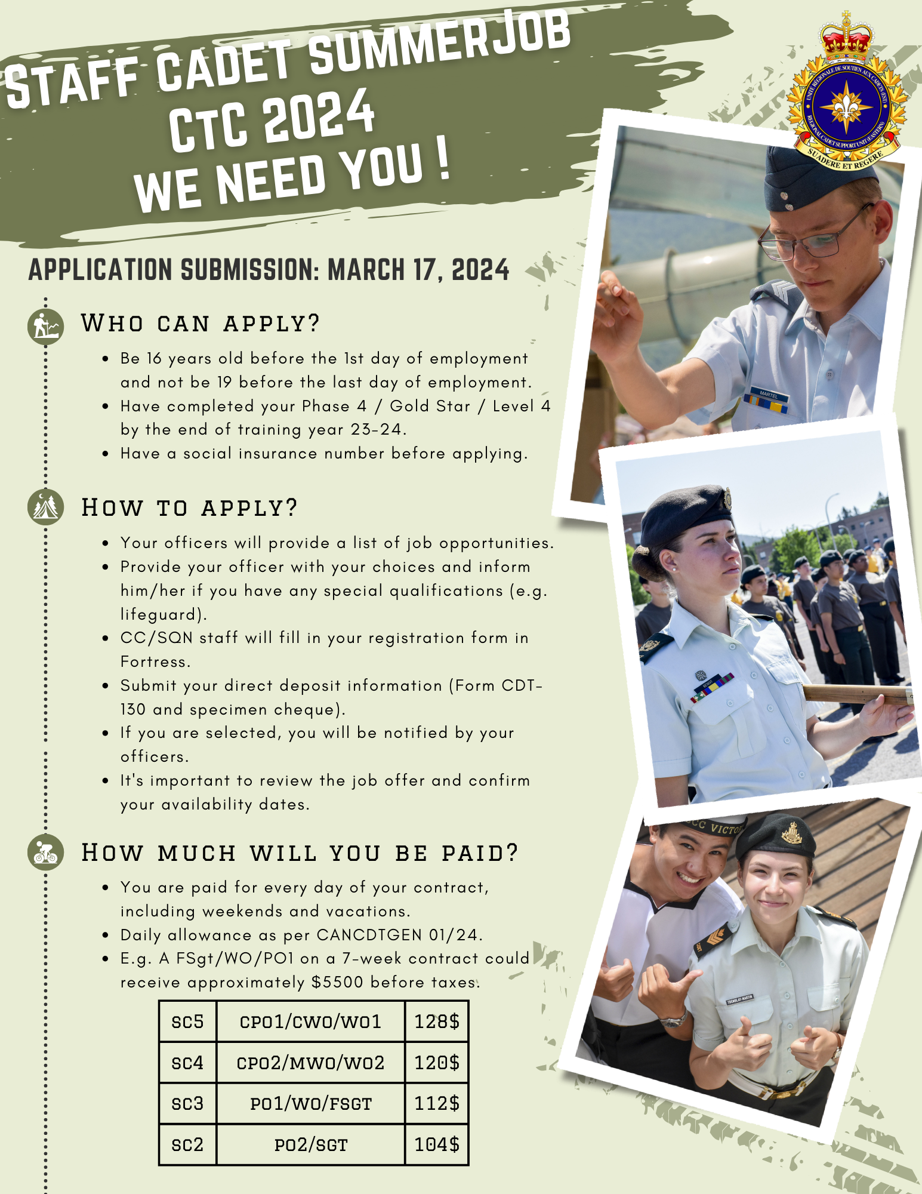
Where to apply in Eastern Region?
CTC VALCARTIER
CTC BAGOTVILLE
CTC ST-JEAN
Where to apply out of region?
CTC ARGONAUT
CTC BLACKDOWN
CTC ROCKY MOUNTAIN
CTC VERNON
HMCS QUADRA

Slide 6
CJCR Gp Technology and Digital Learning Centre
Cyber Safety and Security Team Leader
Nova Quest
Basic Microdrone Operator
Small Craft Operator
Support Service Team Leader
Basic Coder
Tri elemental

Slide 7
***Important***
Cadets attending to virtual training require:
Laptop/computer
Stable Internet connection
Webcam and microphone
Active Cadet365 account
Knowledge of Microsoft Teams

Slide 8
Cyber Safety and Security Team Leader
Prerequisites
Age : N/A
Course objectives
Provides cadets the opportunity to engage with cyber security experts in the Canadian Armed Forces, recognize security measures in Windows and Linux, and participate in a cybersecurity competition.
Date
22 July t0 2 August 2024
Cadets attending this course, if successful, can achieve the Cyber Leader certification. This will help them practice safe online behaviours and be prepared to lead cybersecurity activities in their corps or squadron.
Phase 3 / Silver star / Level 3 completed
Laptop/computer able to operate VMware player (not compatible with Chromebooks)
Language : French / English

Slide 9
Support Service Team Leader
Prerequisites
Âge : N/A
Course objectives
The Support Services Team Leader course provides cadets the opportunity to gain an understanding of the internal operations of cadet corps and squadron and how to provide support areas such as Supply and Administration. Cadets attending this course, if successful, can achieve WHMIS Certification.
Date
8 to 19 July 2024
.
Phase 3 / Silver star / Level 3 completed
Digital Camera (Mobile or Separate)
Language : French / English

Slide 10
Small Craft Operator
Prerequisites
Age : N/A
Course objectives
provides cadets the opportunity to learn about vessel operations, restrictions, and navigation. They will also learn about aspects of on-water communication, such as distress signals, Maritime Mobile Service, and Radio Operations.
Date
22 July to 2 August 2024
Phase 3 / Silver star / Level 3 completed
Cadets attending this course, if successful, can achieve SCOP Module 1 (Pleasure Craft Operator Competency) and SCOP Module 2 (Restricted Radio Operator's Certificate [Maritime]).
Language : French / English

Slide 11
Basic Microdrone Operator
Prerequisites
Âge : N/A
Course objectives
The Basic Microdrone Operator course provides cadets the opportunity to learn about drones in the Canadian Armed Forces, prepare for the Transport Canada exam, and explore careers involving drones.
Date
5 to 16 August 2024
Phase 3 / Silver star / Level 3 completed
Cadets attending this course, if successful, can achieve Transport Canada certification.
Language : French / English

Slide 12
Nova Quest
Prerequisites
Âge : N/A
Course objectives
The Nova Quest course provides cadets the opportunity to explore the Canadian Aerospace industry, its exciting past, and the potential future for advanced space technologies.
Date
5 to 16 August 2024
Phase 3 / Silver star / Level 3 completed
Minimum Hardware:
Processor: Intel® Core™ i5, or AMD Ryzen™ 5
Memory/RAM: 8 GB
Disk Space: 3 GB
Graphics Card: graphic card must support OpenGL 2.0.
1 GB (minimum)
No Chrome Books or Apple Computers
Activities include simulating life in space, and its intricacies in survival, communication, and exploration, identifying celestial objects, and exploring new technologies in the aerospace world.
Language : French / English

Slide 13
Basic Coder
Prerequisites
Âge : N/A
Course objectives
The Basic Coder course provides cadets the opportunity to explore coding and digital creativity. Activities include learning to use block code in Minecraft and coding a VR robot. Cadets will develop a digital community, compete in eSports competitions, and engage in discussions with the Canadian Armed Forces.
Date
22 July to 2 August 2024
Phase 3 / Silver star / Level 3 completed
Language : French / English

Slide 14
Elemental summer training courses
AIR CADET
ARMY CADET
NAVY CADET

Slide 15
Sail 1
Sail 2
Seamanship
Ship’s Boat Operator

Slide 16
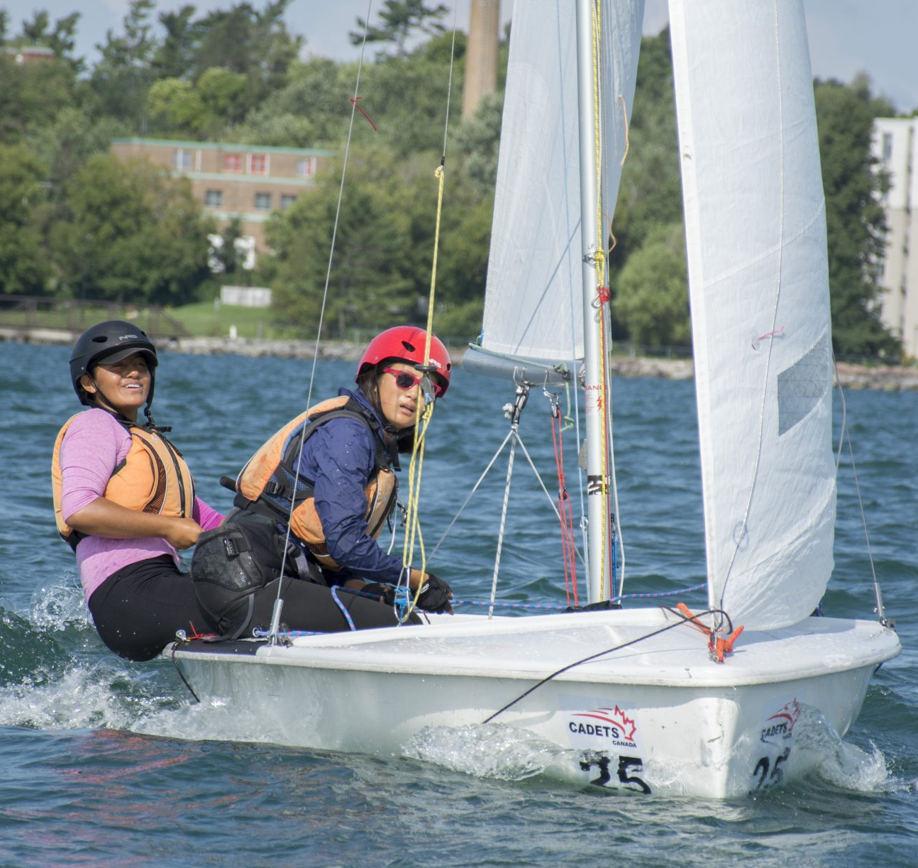
Sail 1 (S1) Bagotville CTC
Prerequisite
Age : N/A
Phase 2 completed
Course objectives
Offers cadets the chance to expand upon their previously acquired seamanship skills from the corps level and engage in advanced seamanship activities. These activities encompass ropework, rigging, serving as a crew member in whaler operation, participating in a day sail on a training vessel, and learning naval communication. Successful completion of this course enables cadets to attain Communications 1 and 2 qualifications..
Date
21 July to 10 August 2024
Language : French

Slide 17
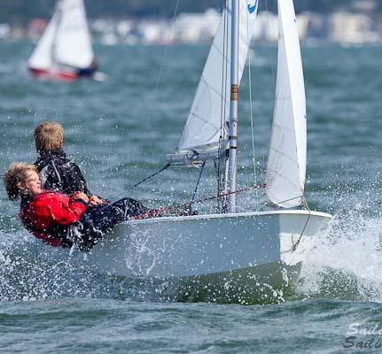
Sail 2 (S2)
Bagotville CTC
Prerequisite
Age : N/A
Phase 3 completed
Course objectives
Offre aux cadets l'occasion de développer davantage leurs compétences en voile et de participer à la formation du Programme d'opérateur d'embarcations légères (POEL). Les cadets qui suivent ce cours, s'ils le réussissent, peuvent obtenir des qualifications VoileCAN 3-4, POEL Module 2 (Certificat restreint d'opérateur radio [maritime]) et POEL Module 3 (Opérer un bateau à moteur avec un moteur hors-bord).
Date
30 juin au 10 août 2024 (6 weeks)
CanSail 1 and 2
SCOP 1
Language : French

Slide 18
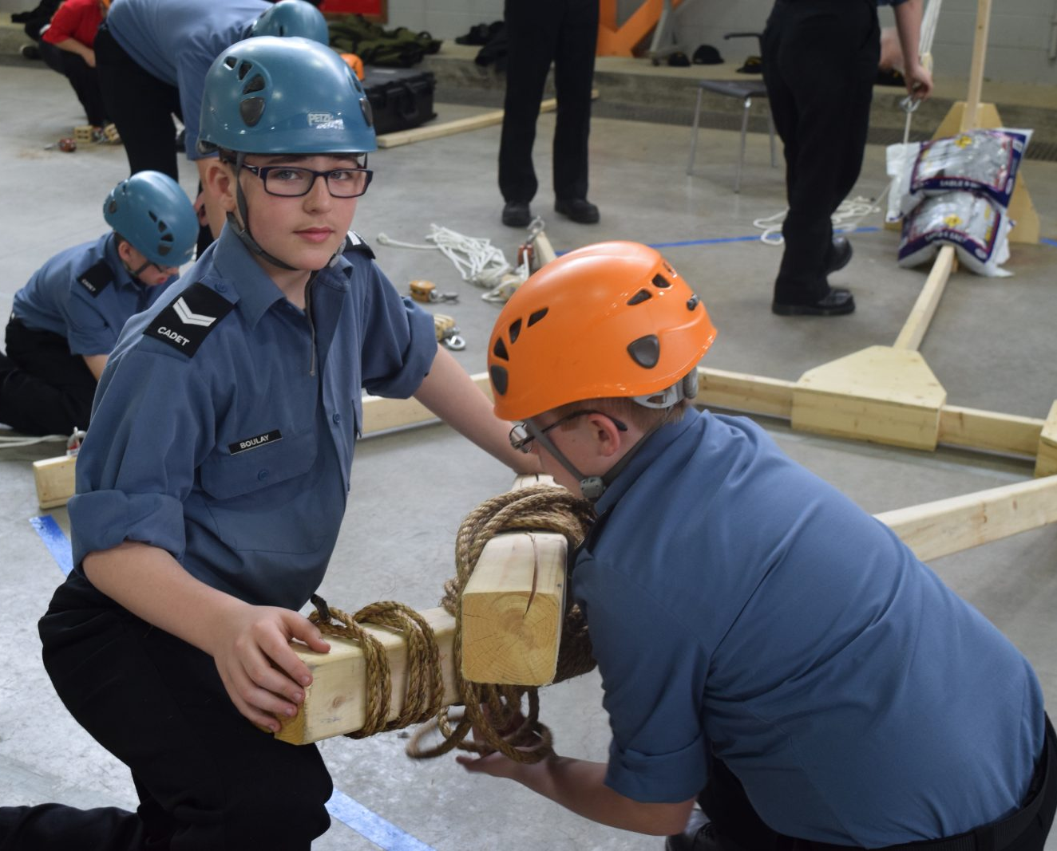
Seamanship (Sea) Bagotville CTC
Prerequisite
Age : N/A
Phase 2 completed
Course objectives
Offers cadets the chance to expand upon their previously acquired seamanship skills from the corps level and engage in advanced seamanship activities. These activities encompass ropework, rigging, serving as a crew member in whaler operation, participating in a day sail on a training vessel, and learning naval communication. Successful completion of this course enables cadets to attain Communications 1 and 2 qualifications.
Date
30 juin au 13 juillet 2024 (2 weeks)
Language : French

Slide 19
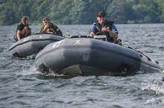
Ship’s Boat Operator (SBO)
Bagotville CTC
Prerequisite
Age : N/A
Phase 3 completed
SCOP 1
Course objectives
Provides cadets an opportunity to develop advanced seamanship skills and participate in Small Craft Operator Program (SCOP) training. Activities include ropework, marine navigation, naval visual communication training and a multi-day on-water trip. Cadets attending this course, if successful, can achieve qualifications in SCOP2 (Attain the ROC (M) with DSC Endorsement), SCOP 3 (Operate a Powerboat with an Outboard Engine) and obtain a standard first aid qualification.
Date
14 July to 10 August 2024 (4 weeks)
Language : French

Slide 20
Advanced Aviation
Aviation Technology and Aerospace
Survival Instructor
Introduction to
survival

Slide 21
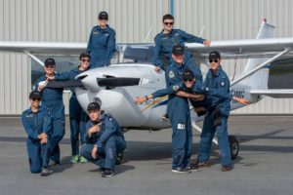
Advanced Aviation (AA) Argonaut CTC, Blackdown CTC, HMCS QUADRA CTC, Valcartier CTC
Prerequisites
Age : N/A
Level 3 completed
Course objectives
Provides cadets an opportunity to develop as a specialist with the skills and subject matter knowledge required to be an instructor and team leader for aviation activities. Activities include instructional techniques, aviation communication, and meteorology.
Date
Argonault (4 weeks) : 28 July to 23 August 2024 Blackdown (4 weeks) : 7 July to 2 August 2024
HMCS QUADRA (4 weeks): 14 July to 10 August 2024 Valcartier (4 weeks) : 14 July to 10 August 2024
Language : French - Valcartier / English – Argonaut, Blackdown and HMCS QUADRA

Slide 22
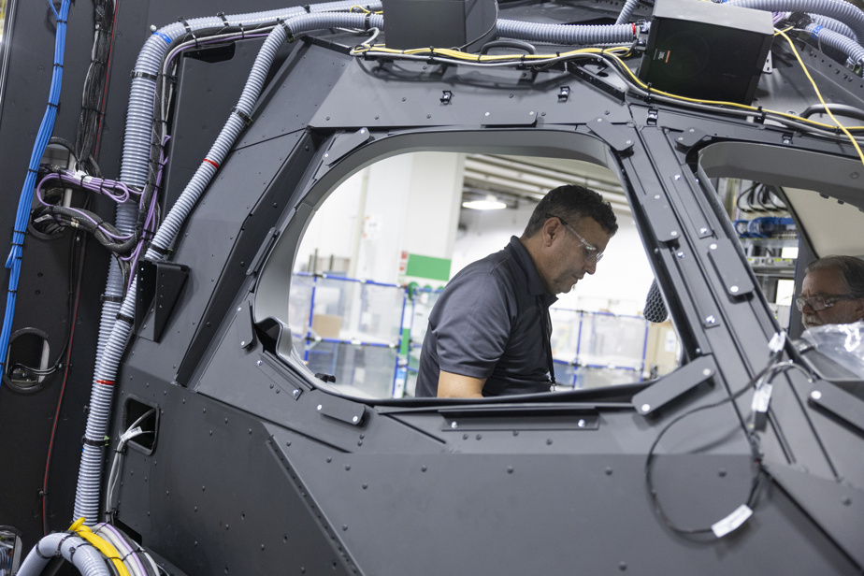
Aviation Technology and Aerospace (ATA) Argonaut CTC, NCSM QUADRA CTC, Valcartier CTC
Prerequisites
Age : N/A
Course objectives
Date
Argonault (2 weeks) : 14 to 26 July 2024 HMCS QUADRA (2 weeks): 14 to 26 July 2024 Valcartier (2 weeks) :
a. 14 to 26 July 2024
b. 28 July to 10 August 2024
Level 2 completed
Offers cadets the chance to lay the groundwork in aerospace studies, airport operations, and the principles of aircraft manufacturing and maintenance. Activities within this program encompass exploring aerospace concepts, learning about aerodrome operations, and gaining insight into aircraft manufacturing and maintenance processes.
Language : French - Valcartier / English – Argonaut and NCSM QUADRA

Slide 23
Introduction to survival (ITS) BlackdownCTC , Valcartier CTC, Vernon CTC
Prerequisites
Age : N/A
Niveau : Niveau 2 complétée
Course objectives
Allows cadets to cultivate essential aircrew survival skills. Activities involve practical field training and navigation exercises to enhance survival proficiency.
Date
Blackdown (2 semaines) : 4 to 16 August 2024 Valcartier (2 semaines) : a. 14 July to 27 July 2024
b. 28 July to 10 August 2024
Vernon (2 semaines) : 14 to 27 July 2024
Language : French- Valcartier / English – Blackdown and Vernon

Slide 24
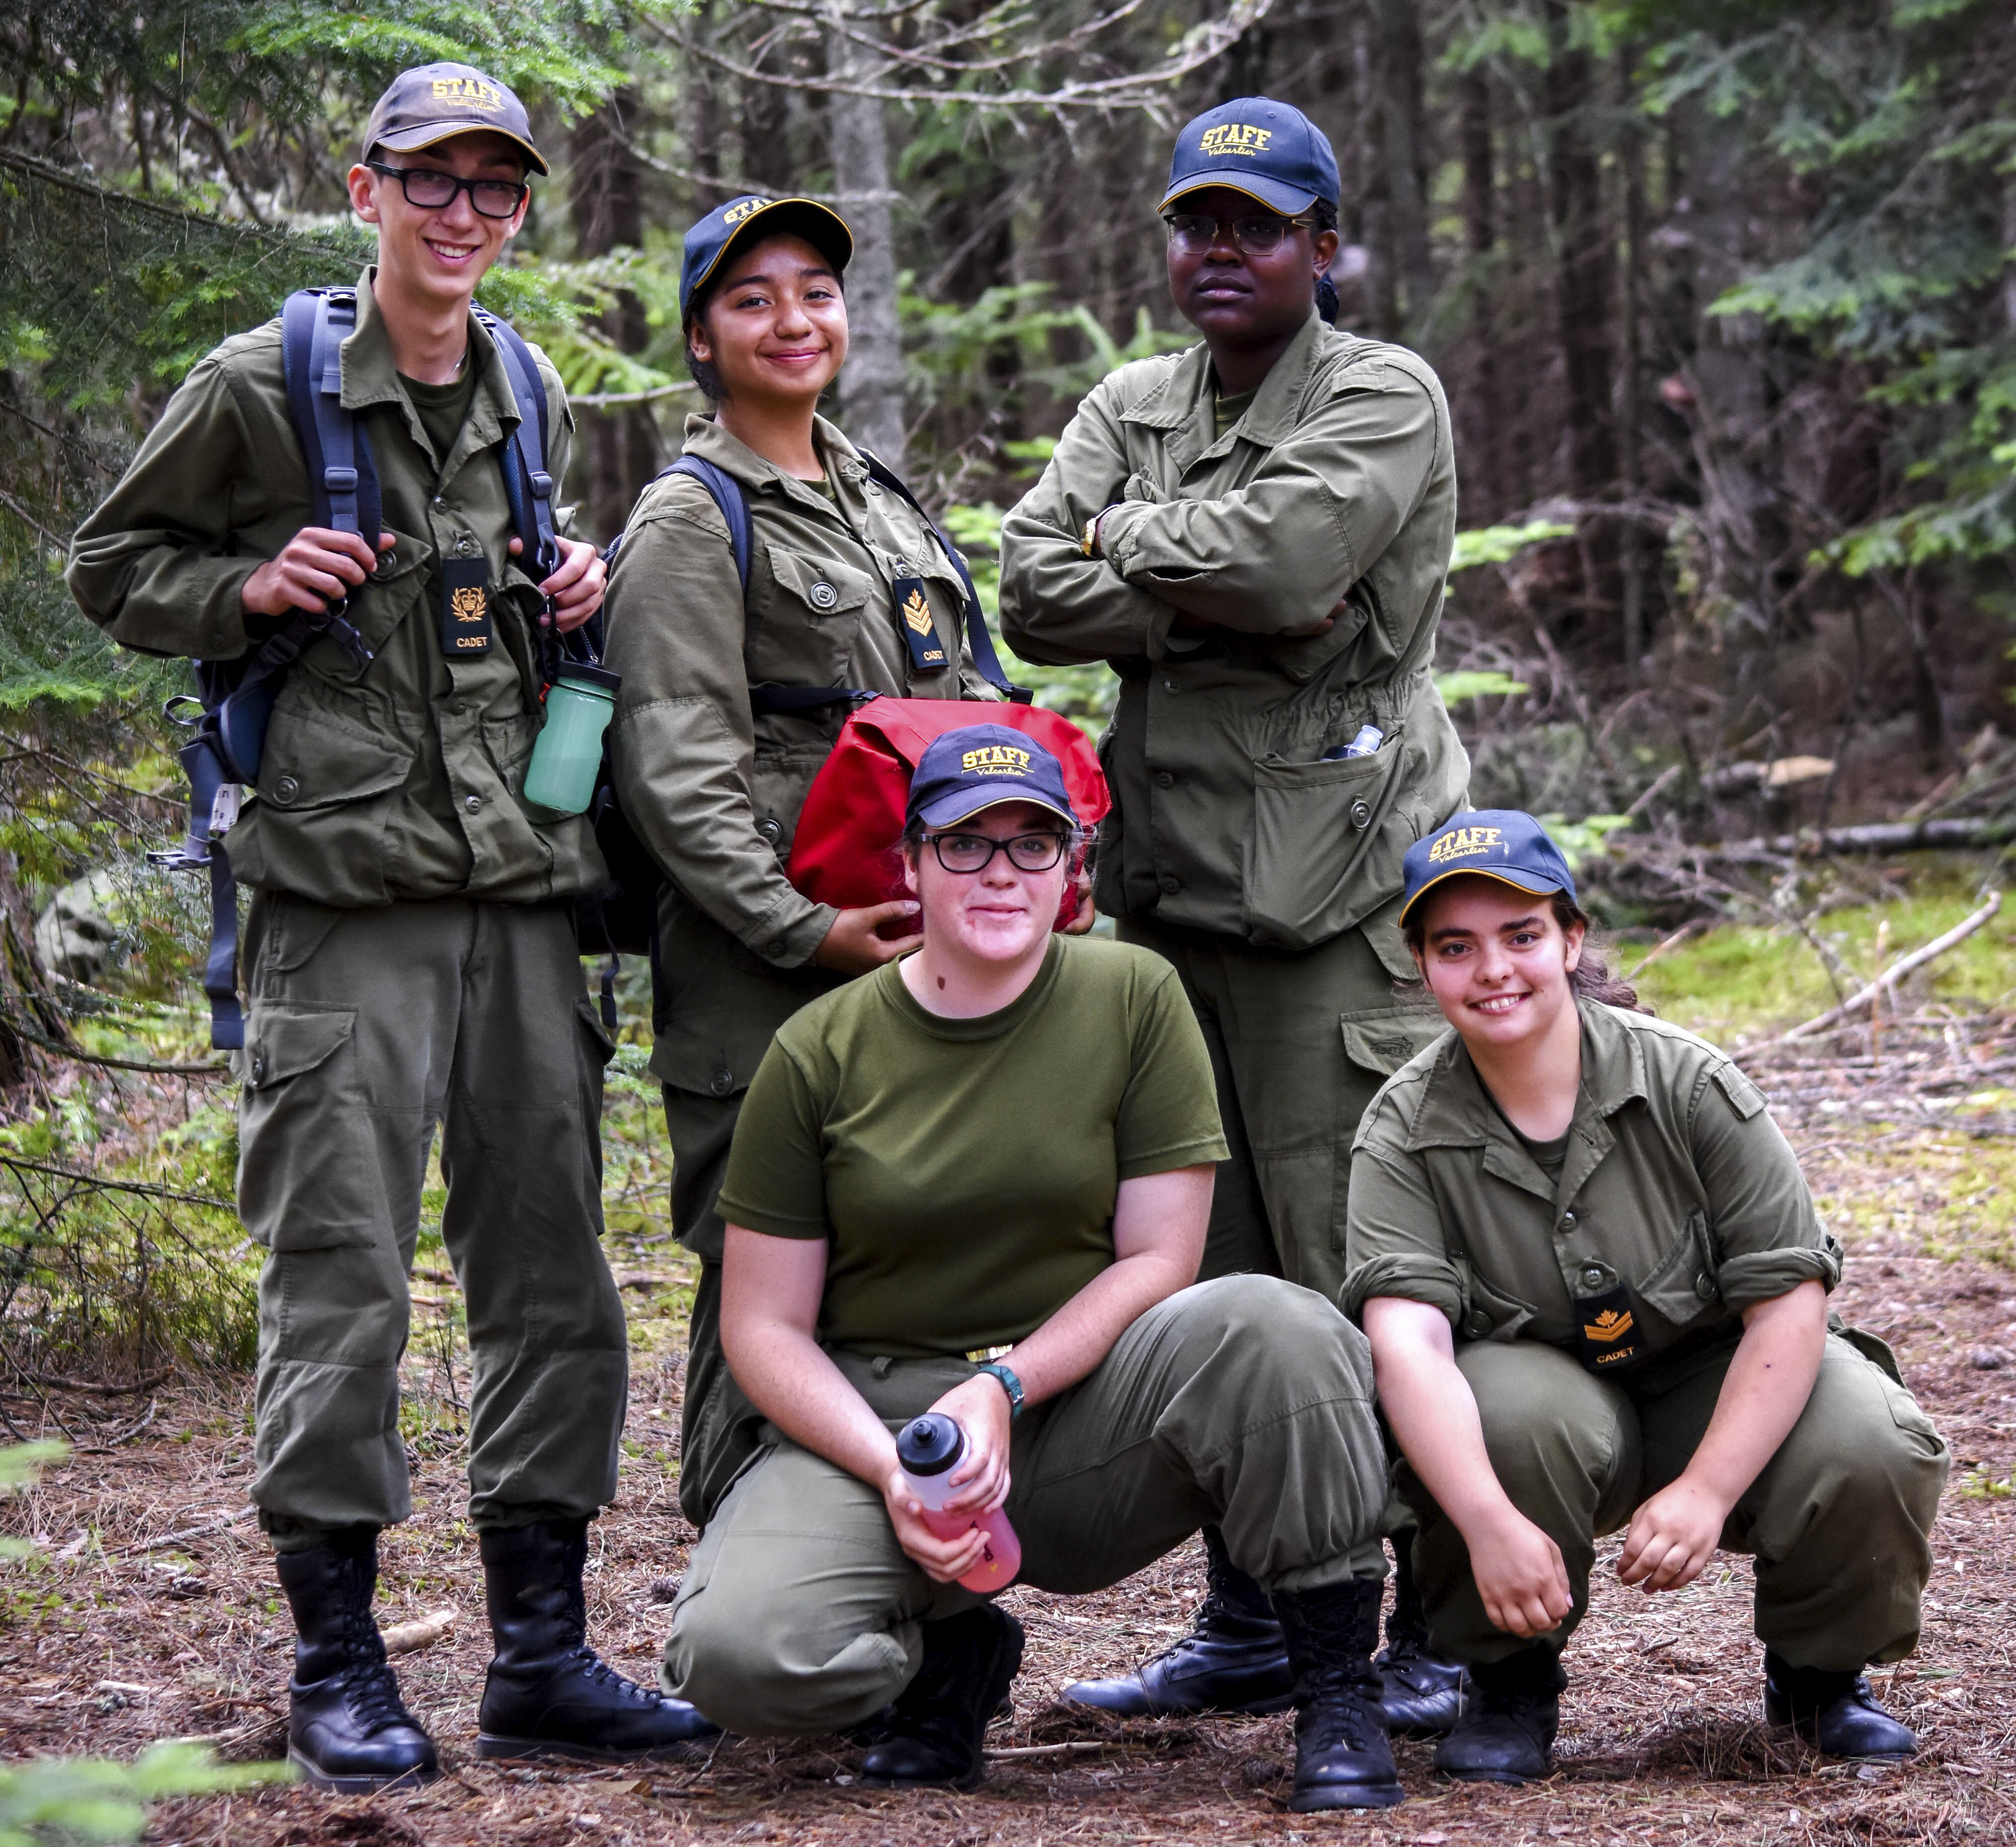
Survival Instructor (SI) Valcartier CTC
Prerequisites
Age : N/A
Course objectives
Provides cadets an opportunity to develop as a specialist with the skills and subject matter knowledge required to perform the duties of a Survival Instructor and team leader for aircrew survival activities. Activities include aircrew survival skills, team and solo survival exercises, aircrew survival exercise operations, instructional technique, and navigation by map and compass.
Date
14 July to 10 August 2024 (4 weeks)
Level 3 completed
Language : French / English

Slide 25
Expedition Team Member
Expedition Team Leader
Basic Parachutist
Mountain Bike Instructor

Slide 26
Expedition Team Member (ETM)
Valcartier CTC, Rocky Mountain CTC
Prerequisite
Age: 14 Years Old at the course start date
Silver star completed
Course objectives
Allows cadets to deepen their understanding and proficiency in expedition-related knowledge and skills. It focuses on building the foundational competencies required for serving as an Expedition Team Member. Activities encompass navigation training, a five-day expedition, and specialized adventure training.
Date
Valcartier (2 weeks) : a. 14 to 27 August 2024
b. 28 July au 10 August 2024
Rocky Mountain (2 weeks) : 11 to 24 August 2024
Language : French - Valcartier / English - Rocky Mountain

Slide 27
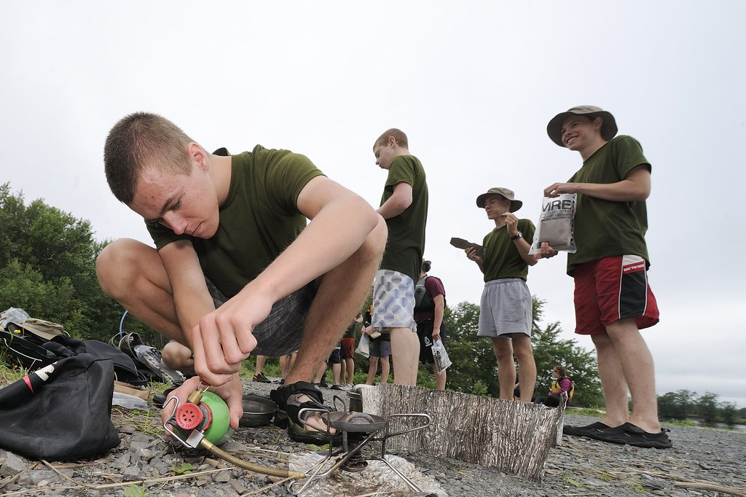
Expedition Team Leader (ETL)
Valcartier CTC , Blackdown CTC
Prerequisite
Age : N/A
Silver star completed
Course objectives
Provides cadets an opportunity to cultivate outdoor leadership skills and develop as a specialist with the skills and subject matter knowledge to perform the duties of an Expedition Team Leader within the Army Cadet Program. Activities include navigation, a multi-day expedition, adventure training, leadership, and instructional technique.
Date
Valcartier (4 weeks) : 14 July to
Blackdown (4 weeks) : 7 July to
2 August 2024
10 August 2024
Language : French - Valcartier / English - Blackdown

Slide 28
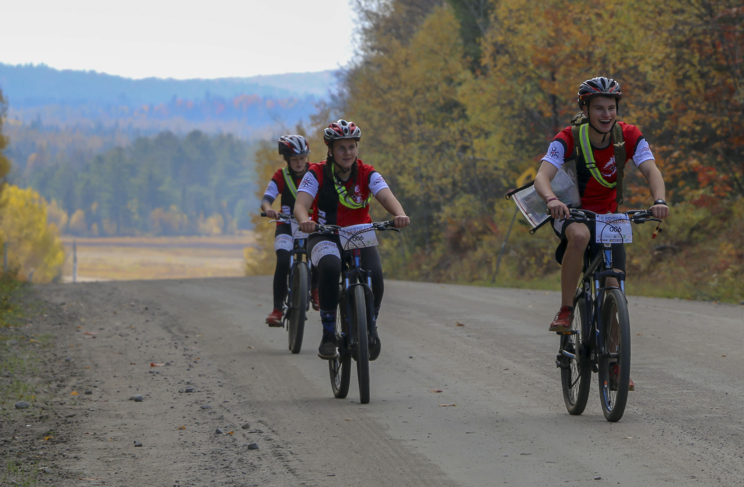
Mountain Bike Instructor (MBI) Rocky Mountain CTC
Prerequisite
Age : N/A
Gold star completed
Course objectives
Provides cadets an opportunity to develop the specialist skills required to perform as a Mountain Bike Instructor at the cadet corps, summer training centre and on expeditions. Activities include riding a mountain bike on intermediate and advanced trails, conducting a mountain bike activity, and performing repairs on a mountain bike.
Date
28 July to 10 August 2024 (2 weeks)
Language : French / English

Slide 29
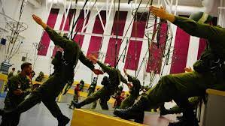
Basic Parachutist (PARA)
Trenton CTC
Prerequisite
Age : 16 Years Old at the course start date
Gold star completed
Enrolment NLT 31 March 2023
Course objectives
Provides cadets an opportunity to develop the skills and knowledge to become a Canadian Forces (CF) Basic Paratrooper. Cadets selected for this course will participate in intense high-level physical training activities in remote locations and in high altitudes. Prior to attending the course, cadets will need to be certified by a CF medical officer as being physically and mentally fit, with no medical limitations.
Date
1 to 26 July 2024 (4 weeks)
Language : French / English

Slide 30
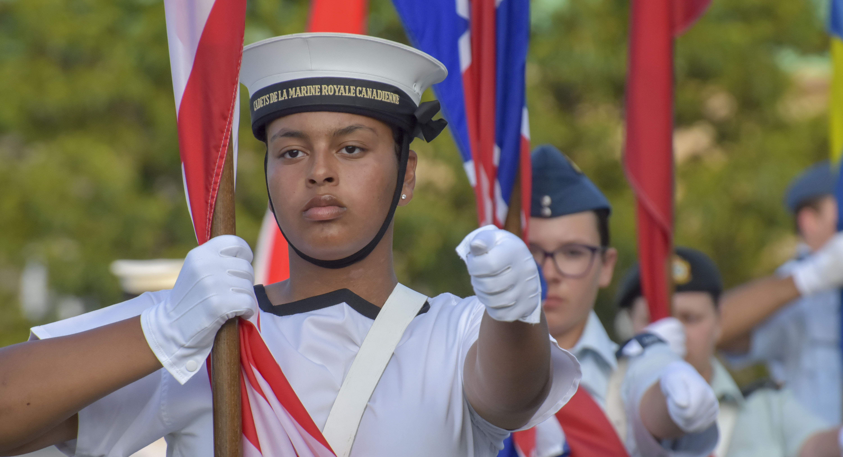
Common courses
Drill and ceremonial
Fitness and sport
Markmanship
Music / Band pipe

Slide 31
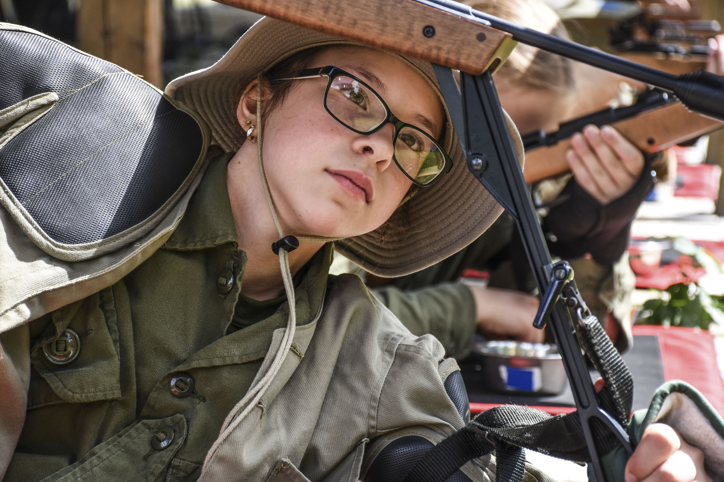
Introduction to Marksmanship(ITM)
Valcartier CTC , Vernon CTC
Prerequisites
Age : N/A
Niveau : Phase 2 / Red star / Level 2 completed
Course objectives
Enables cadets to acquire specialized skills and knowledge in marksmanship, facilitating their participation in zone and regional marksmanship competitions. It equips them to mentor junior cadets in marksmanship while advancing the skills learned in the program.
Date
Valcartier (2 weeks):
a. 14 to 27 July 2024 b. 28 July to 10 August 2024
Vernon (2 weeks):
14 to 27 July 2024
Language : French - Valcartier / English - Vernon

Slide 32
Air Rifle Marksmanship Instructor (ARMI) CEC Valcartier
Prerequisite
Age : N/A
Phase 3 / Silver star / Level 3 completed
Objectifs du cours
Provides cadets an opportunity to further personal marksmanship knowledge and skills, and develop as a specialist with the skills and subject matter knowledge to perform the duties of an Air Rifle Marksmanship Instructor. Activities include marksmanship techniques, instructional techniques, and coaching. Cadets attending this course will also have an opportunity to progress in their marksmanship level qualification.
Date
14 July to 10 August 2024 (4 weeks)
Language : French / English

Slide 33
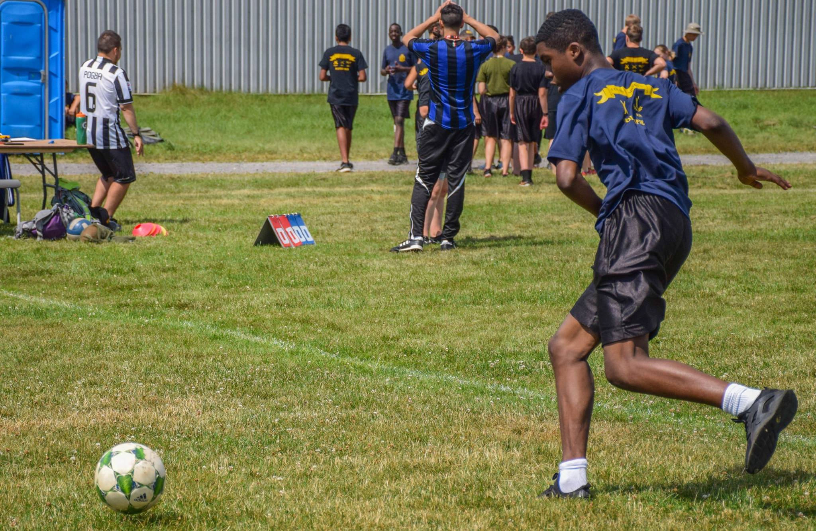
Introduction to Fitness and Sports (ITFS) Valcartier CEC
Prerequisites
Age : N/A
Niveau : Phase 2 / Red star / Level 2 completed
Objectifs du cours
Offers cadets a chance to refine skills acquired in the Corps/Squadron Program, aiding in fitness and sports training within the Corps/Squadron Program. Additionally, participants learn about embracing a healthy lifestyle.
Date
2 weeks:
a. 14 to 27 July 2024
b. 28 July to 10 August 2024
Language : French / English

Slide 34
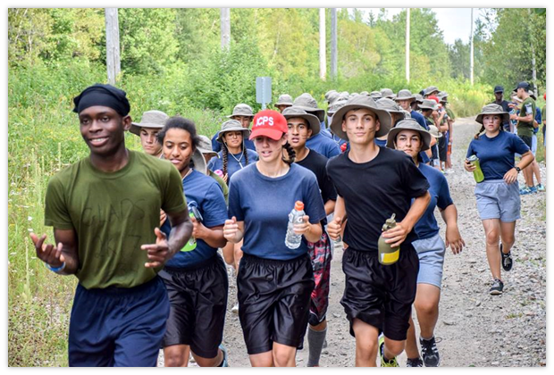
Fitness and Sports Instructor (FSI) Valcartier, CTC
Prerequisites
Age : N/A
Objectifs du cours
Provides cadets an opportunity to further personal fitness and healthy living knowledge and skills, and develop as a specialist with the skills and subject matter knowledge to perform the duties of a Fitness and Sports Instructor. Activities include personal fitness, healthy living, conducting the Cadet Fitness Assessment, and leading physical activities.
Date
14 July to 10 August 2024
(4 weeks)
Phase 3 / Silver star / Level 3 completed
Language : French / English

Slide 35
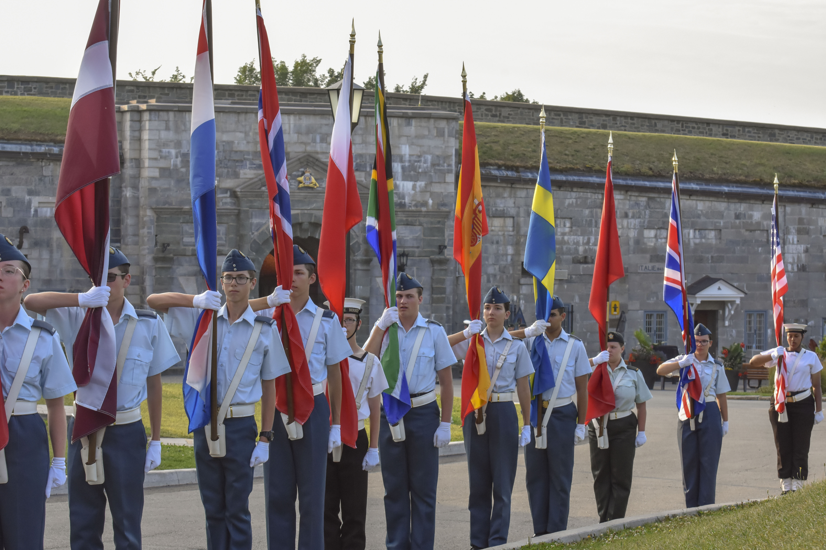
Introduction to Drill and Ceremonial (ITDC)
Valcartier CTC, Vernon CTC
Prerequisites
Age : N/A
Course objectives
Engages cadets with the chance to enhance their leadership abilities and deepen their knowledge and skills in drill and ceremonial practices acquired in the program.
Date
a. Valcartier et Vernon: 14 to 27 July 2024 (2 weeks)
b. Valcartier: 28 July to 10 August 2024 (2 weeks)
Niveau : Phase 2 / Red star / Level 2 completed
Language : French - Valcartier / English - Vernon

Slide 36
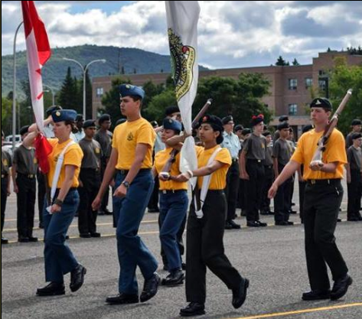
Drill and Ceremonial Instructor (DCI) Rocky Moutain CTC, Valcartier CTC
Prerequisites
Age : N/A
Course objectives
Provides cadets an opportunity to develop as a specialist with the skills and subject matter knowledge to perform the duties of a Drill and Ceremonial Instructor. Activities include advanced drill, instructional techniques and leadership in the conducting of parades and ceremonies.
Date
Valcartier and Rocky Mountain
14 July to 10 August 2024 (4 weeks)
Phase 3 / Silver star / Level 3 completed
Language : French - Valcartier / English – Rocky Mountain

Slide 37
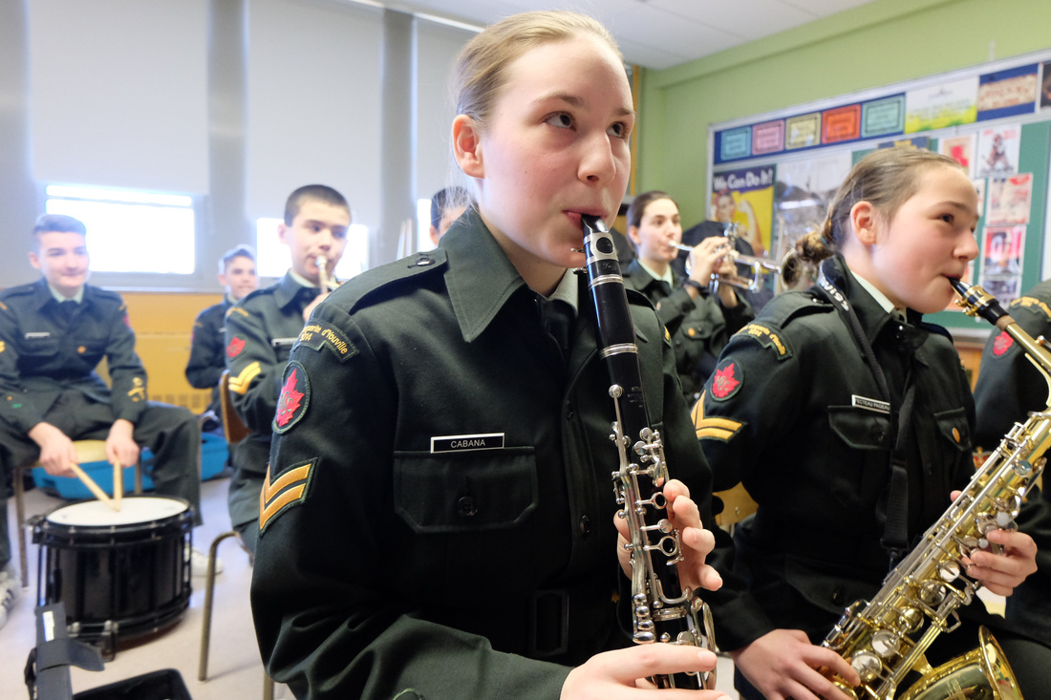
Introduction to military band (ITB)
Blackdown CTC
Prerequisites
Age : N/A
Phase 2 / Red star / Level 2 completed
Course objectives
Allows cadets to continue honing their understanding and proficiency in music, drill, ceremonial practices, and leadership skills acquired through the corps/squadron program or regional activities.
Date
4 to 16 August (2 weeks)
Language : English

Slide 38
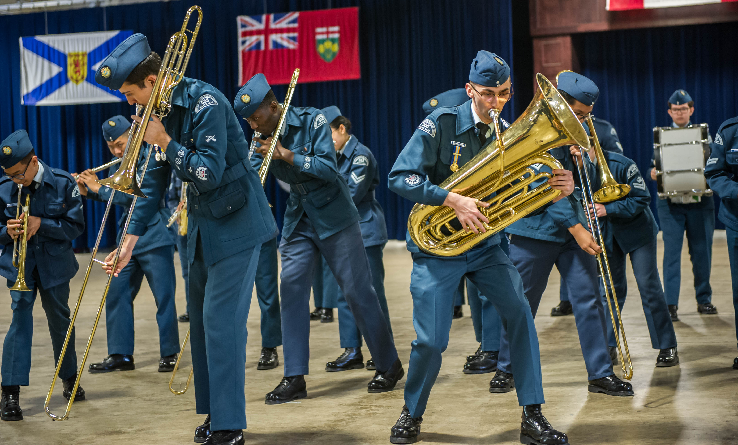
Military Band – Musician cadets (MB)
CEC Valcartier
Prerequisites
Âge : N/A
Phase 3 / Silver star / Level 3 completed
Course objectives
Provides cadets an opportunity to develop music skills to support participation in and / or leading corps/squadron military bands. Activities include music training and band activities such as music theory, music technique, band drill, leadership and performing ensemble music. Cadets attending this course will also have the opportunity to progress in their music proficiency level qualifications.
Date
14 July to 10 August 2024
Music level 2 (Can be waived)
(4 weeks)
Language : French / English

Slide 39
Introduction to pipe band (ITPB)
Blackdown CTC
Prerequisites
Âge : N/A
Phase 2 / Red star / Level 2 completed
Course objectives
Allows cadets to continue honing their understanding and proficiency in music, drill, ceremonial practices, and leadership skills acquired through the corps/squadron program or regional activities.
Date
4 to 16 August (2 weeks)
Language : English

Slide 40
Pipe Band Musician (PBM)
Blackdown CTC
Prerequisites
Âge : N/A
Phase 3 / Silver star / Level 3 completed
Course objectives
Provides cadets an opportunity to develop music skills to support participation in and / or leading corps/squadron pipe bands. Activities include music training and band activities such as music theory, music technique, band drill, leadership and performing pipe band music. Cadets attending this course will also have the opportunity to progress in their music proficiency level qualifications.
Date
7 July to 2 August 2024 (4 semaines)
Pipe level 2 (Can be waived)
Language : English

Slide 41
Cadets training centre – summer 2024
It's a unique and rewarding adventure!

Slide 42
Typical schedule (daily)
TIME |  | SPECIFICATIONS
06h00 | Survey
06h30-08h00 | Breakfast and morning ablutions
08h00-11h30 | Training and activities
11h30-13h00 | Lunch
13h00-17h00 | Training and activities
17h00-18h30 | Dinner
18h30-21h30 | Personal time | There may be instruction after dinner, or a specific activity related to the course.
21h30-22h00 | Bedtime and evening ablutions
22h00 -06h00 | Night | Night-time surveillance by a security team

Slide 43
Frequently Asked Questions (FAQs) -Parents
Can I collect my child on the last day? YES! However, you must inform the camp at least 72 hours in advance - this will help us to manage transport and departures.
Can I pick up my child during the week? t's highly beneficial for your child to fully engage in the scheduled training alongside their peers. This ensures they receive comprehensive information and can fully capitalize on their activities.
Can I contact him while he's at camp? Yes, cadets have access to computers and a WIFI network or a landline so they can get in touch with you! No news, good news ;)

Slide 44
Frequently Asked Questions (FAQs) - Parents
Will my child eat properly? YES! The menus are varied. They can choose what they like from the menu and the side dishes.
Will my child be accommodated? Your child is accommodated in a dormitory with single beds and communal sanitation areas including individual showers and toilets.
Will I have all the information I need before my child leaves? You'll have access to a booklet containing a wealth of information about preparing for camp and camp life.

Slide 45
Frequently Asked Questions (FAQs) - Cadets
Will I be with my friends from my cadet unit? Sometimes yes, sometimes no! It depends on the course you're doing! However, in your free time, you'll be able to see each other and even make new friends.
Can I contact my parents? During free time, there will be a designated area for access to a WIFI network. You can also use a landline to make calls.

Slide 46
THANK YOU

